Slide 1


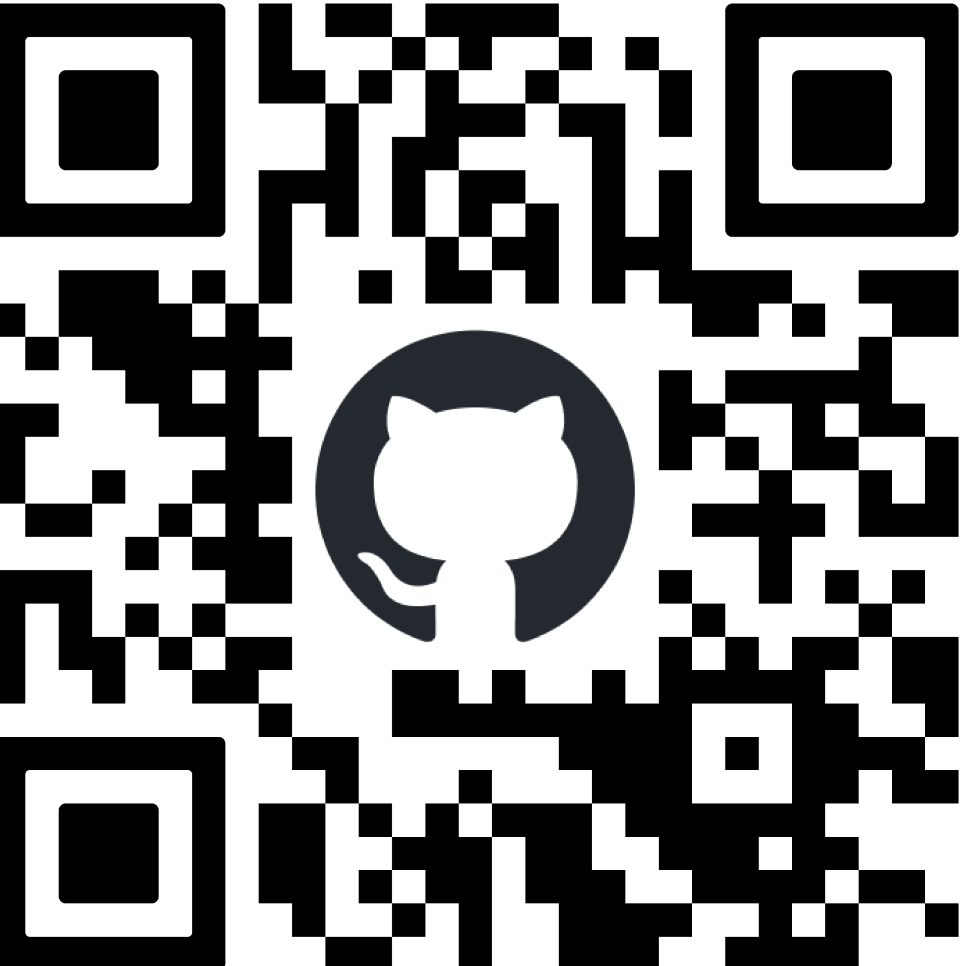



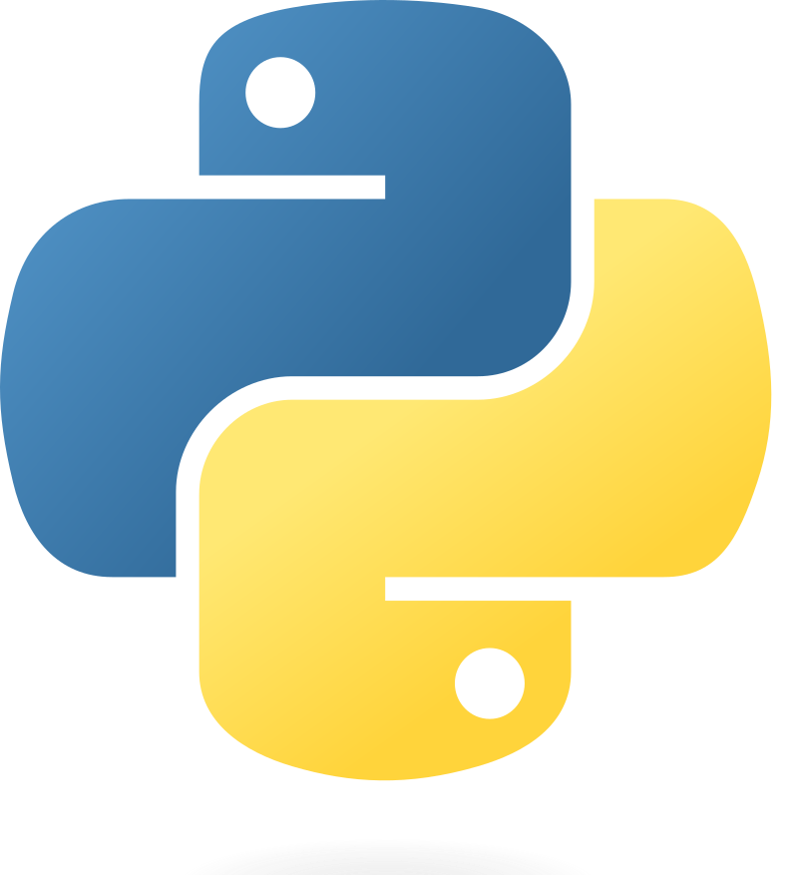

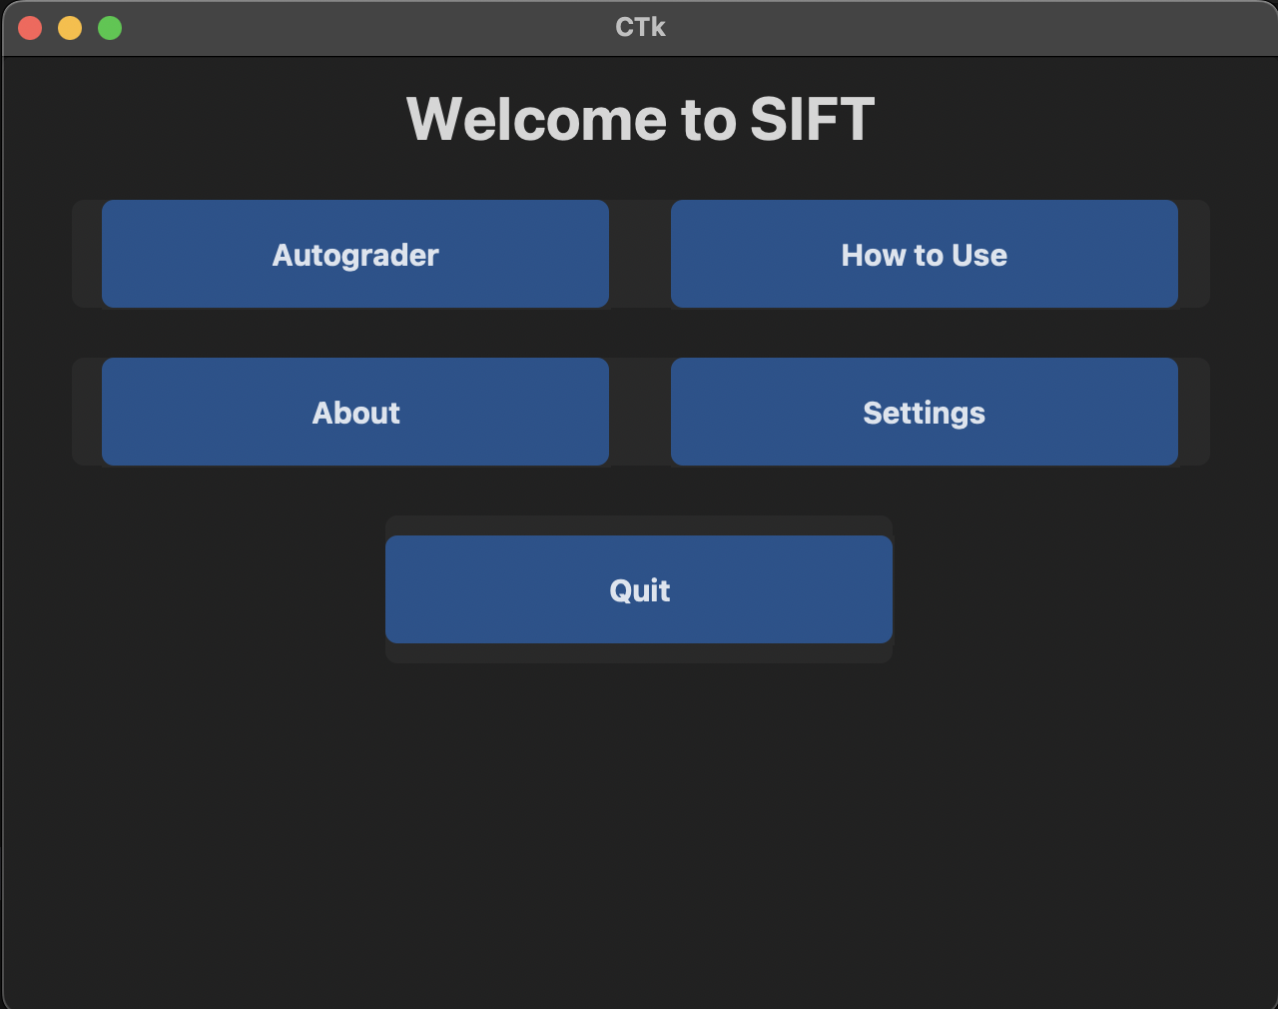
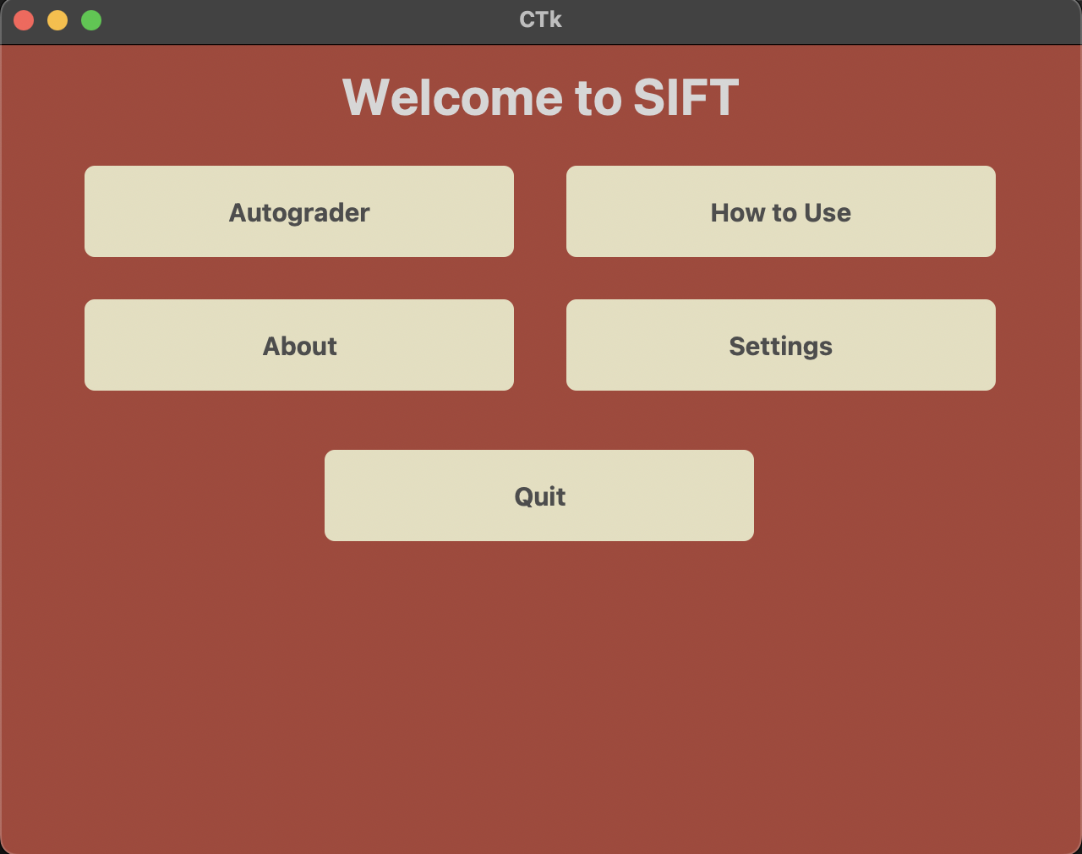
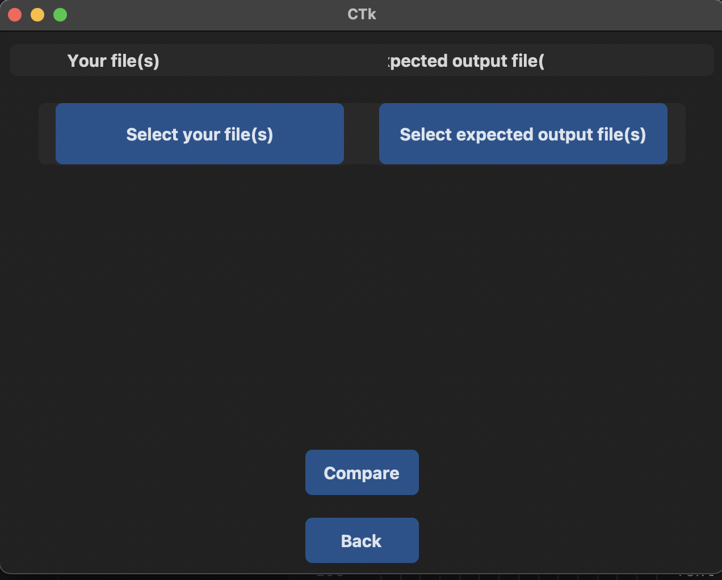
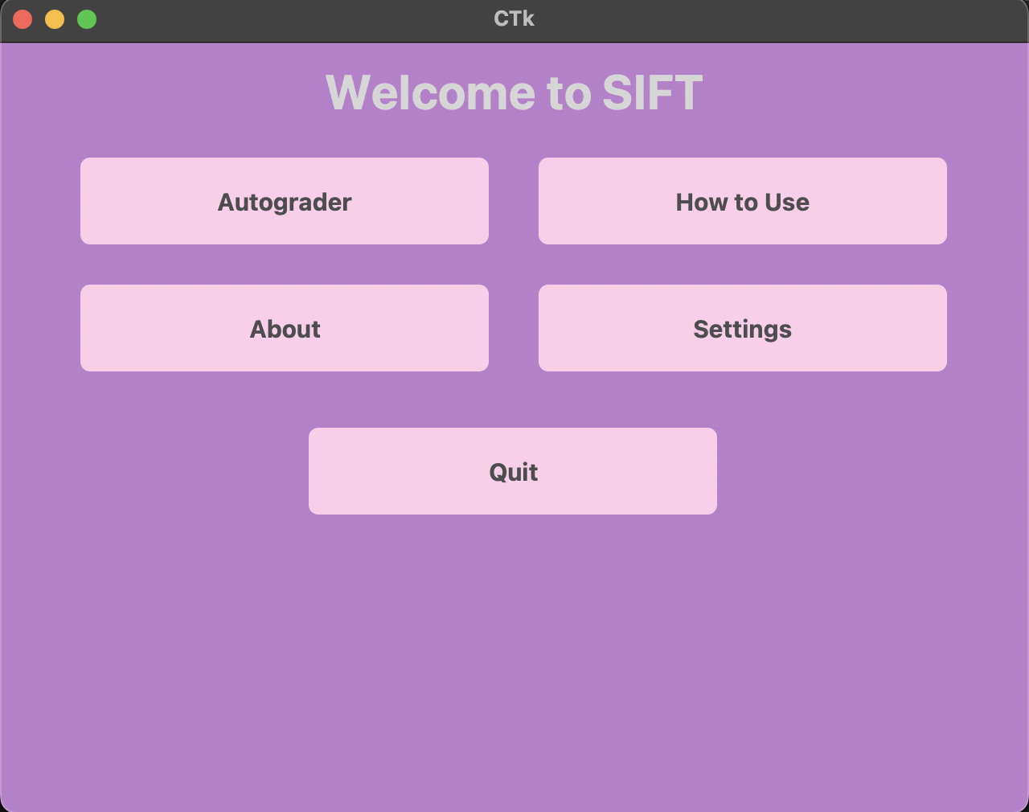
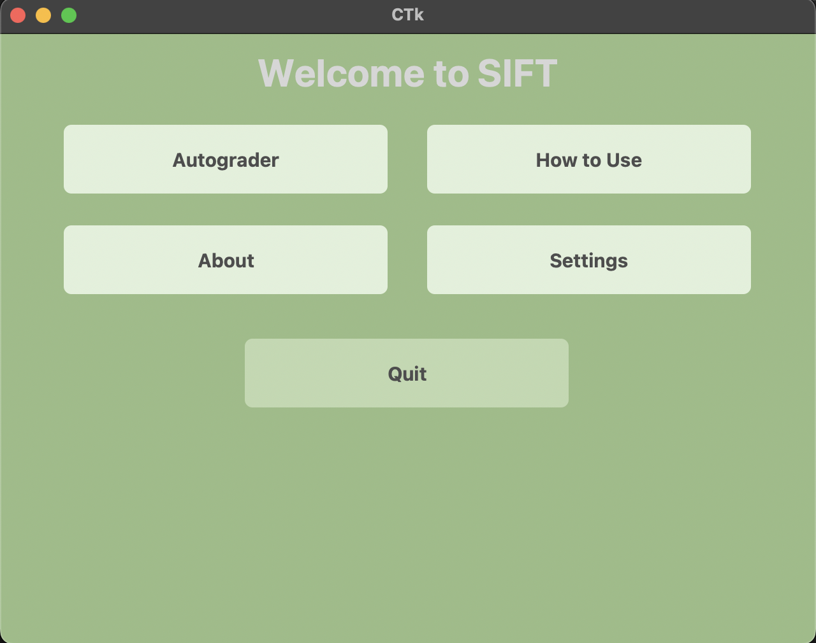
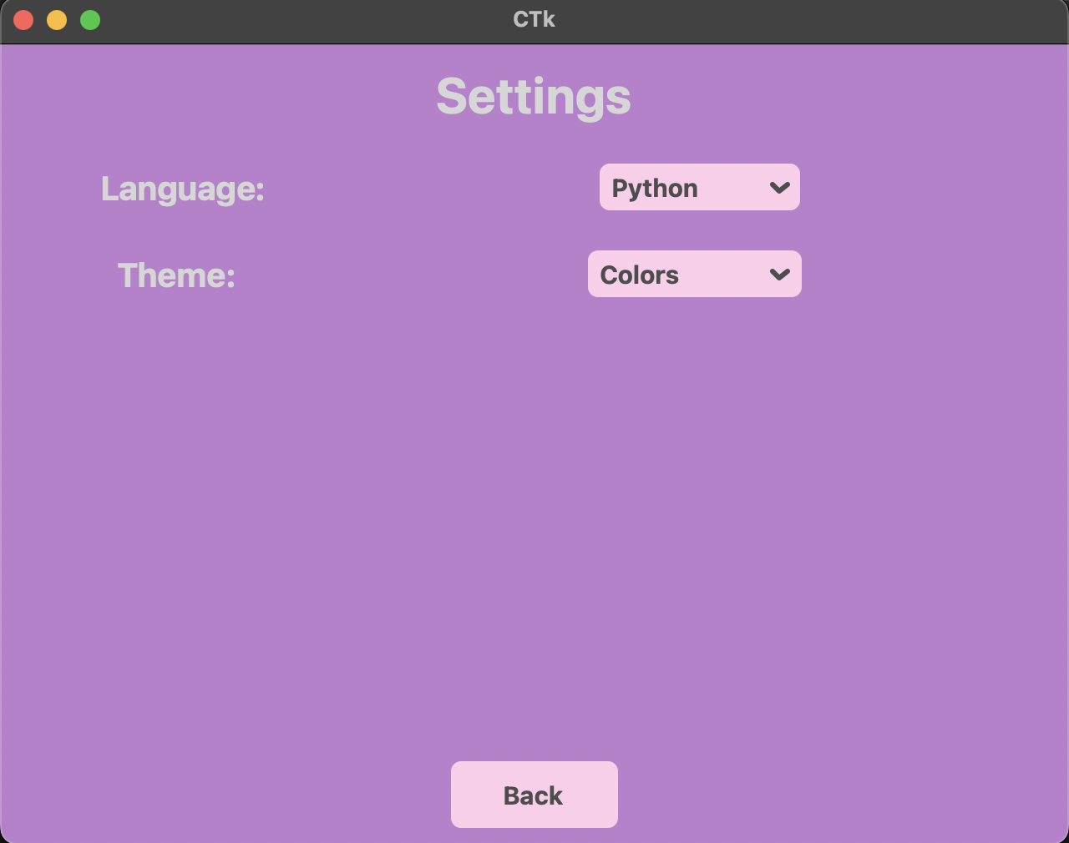
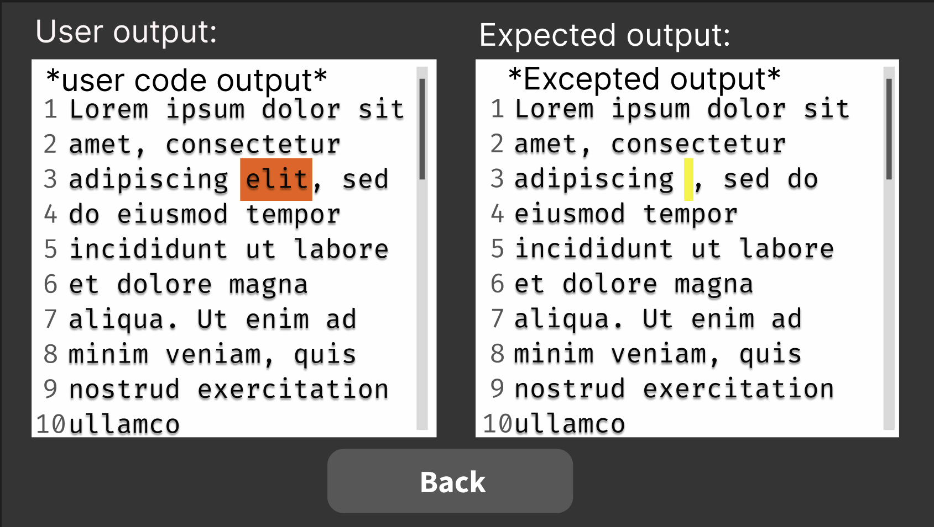
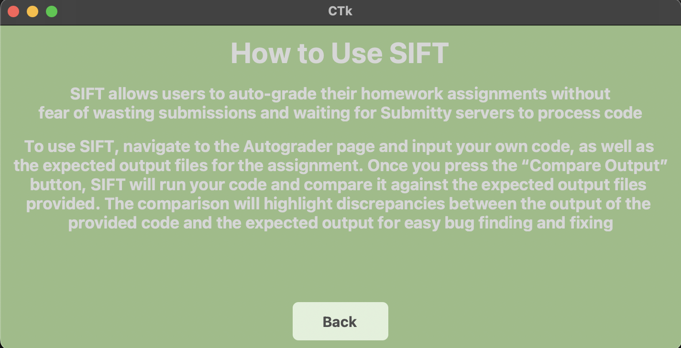
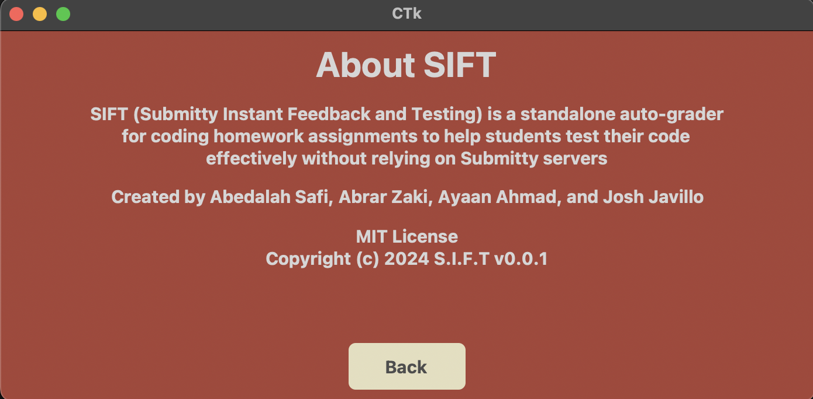
SIFT: Submitty Instant Feedback and Testing
Abedalah Safi, Abrar Zaki, Ayaan Ahmad, Joshua Javillo
Introduction
Objectives
Materials and Methods
Frontend/UI
SIFT or Submitty Instant Feedback and Testing is a standalone app that enables students to autograde their Submitty coding homework assignments without having to rely on Submitty
Oftentimes, working with the Submitty autograder to test and find problems in code can be cumbersome, requiring the user to upload all their files, wait for the servers to process and run them, and then getting your output, all while using up a precious submission
SIFT aims to fix this by giving students the tools to get their homeworks graded on their own computers.
Users begin by selecting the language they are using, upload their own source code files, and the expected output files
SIFT then runs the source code and shows the user the comparison between their output and the expected output that was provided in a similar way to Submitty
The goal of SIFT is to streamline the process of creating and testing code so that students spend less time waiting for Submitty, wasting submissions, and can instead get quick results and keep working
Provide students with a resource to quickly and easily test code anywhere, anytime
Create a user friendly and functional UI
Learn how to run code written in different languages within Python
Encourage students to develop better testing habits
Relieve stress off Submitty servers
Apply the skills we’ve learned to create a useful product
One of our main goals with S.I.F.T was to make an easy-to-run, smooth application. As such:
We decided to run with python because of its extensive library support. Moreover, the whole team has experience in python, so it would make the development process smoother.
Our front-end team, composed of Abrar Zaki and Joshua Javillo, researched for ways to create a simple, easy-to-use UI.
First we researched Tkinter as that is a popular way to make GUIs in python. However, the team found a library built upon Tkinter, called Custom Tkinter that makes it easier to create UI components.
Since we want to be able to run our application across all platforms(Windows, Mac, Linux), we decided on using Docker to distribute S.I.F.T.
We made our mock ups in figma
it was easy to use and it allowed us to easily collaborate with each other.
We decided to make our front end user interface with python and the custom TKinter library. We decided to go with the custom TKinter because:
We thought that it wasn’t too difficult to understand with our group's previous experience in TKinter.
The library had some very nice looking widgets that we wanted to use such as buttons, labels, and option menus.
Our design philosophy when making our frontend was that we wanted to emphasize the discoverability of our application.
we implemented into the ability to change themes.
In the “Settings” frame we allow the user to change the color of the theme that they want the user interface to have.
the app restarts and takes you back to the first frame with the theme now the color that you chose.
Currently there are 5 color themes to choose from, dark, light, red, green and pink.
Visuals
Accomplishments
Future Goals
We started S.I.F.T from scratch, making our UI over the semester
We also implemented different color options for the UI
The user can select what files we they want to run, through their native OS’ file system
We created the user interface using CustomTkinter, a UI library build on top Tkinter for python
We created a backend that is able to run C++, Python, and Java programs
This is done through the python subprocess system
The way we construct paths for our files is OS agnostic, meaning our paths should work on any Operating System
We joined our backend with our frontend
At the moment the programs we run through our print their output to the console
We created a logo
A modified version of the Submitty logo with the duck in a sift
Some of the ideas and goals we have for the future include:
Allowing users to select individual courses and have all the necessary resources already available for them without extra downloads
Allowing professors to upload materials and manage their courses on the app to allow the features mentioned above
Incorporate AI for giving users feedback and tips on how to improve their code/coding habits
Possibly creating a better UI from scratch for more control and more flexible aesthetics
Make the app distributable (through platforms such as Docker)
Acknowledgements
CustomTkInter by Tom Schimansky
TkInter by Steen Lumholt and Guido van Rossum
Python by Guido van Rossum
RCOS professors, coordinators, and mentors

